Slide 1
Drumline Microcontrollers, PCBs & LEds
By, Steve Warren & Braden Rosengren

Slide 2
Steve
Junior in Electrical Engineering
President of Critical Tinkers
Involved with the bands at Iowa State

Slide 3
Braden
Senior in Electrical Engineering
Treasurer of Critical Tinkers
Involved musically at Iowa State

Slide 4
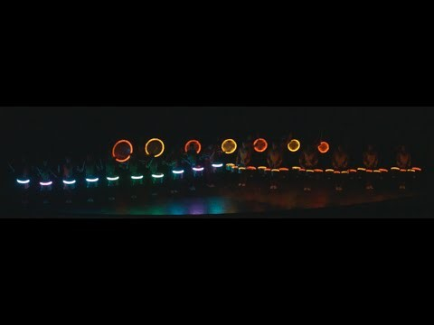

Slide 5

Snares are TI’s MSP430 Launchpad
Run with Digital LEDs
Have nrf radios

Slide 6
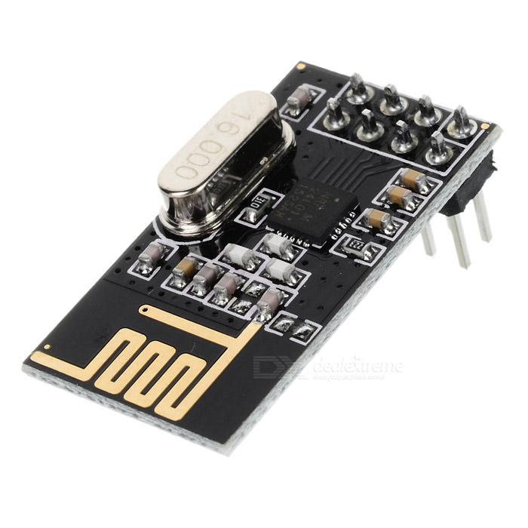
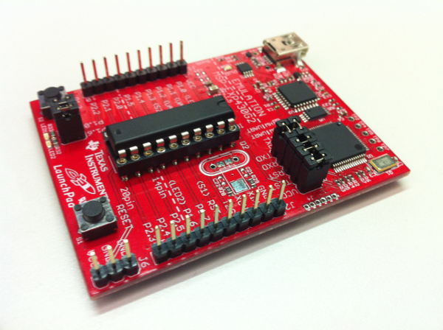
NRF24L01
MSP430
Low cost Microcontroller setup from TI
2.4 GHz, 2Mbps RF transceiver
1.9V-3.3V

Slide 7
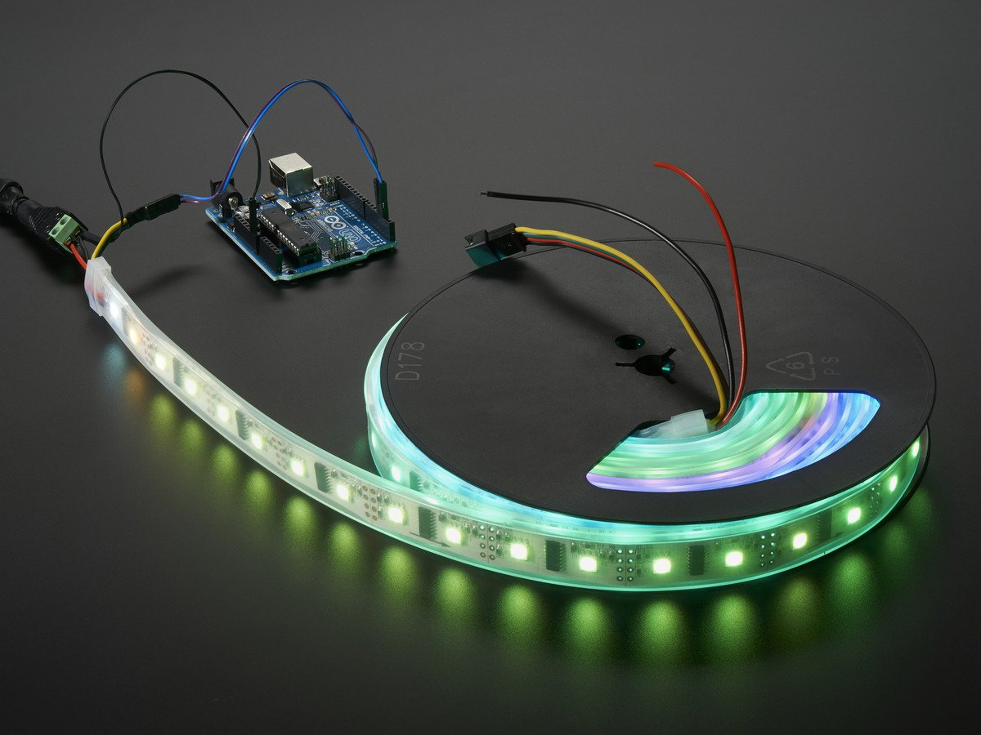
LPD8806
Digitally addressable LEDs

Slide 8

Bass Drum PCB

Slide 9
PCB Design
Great websites are PCB Way – cheap for 10+ boards, fast turn around
Based in Shenzhen China
Definitely not Purple
OSH Park – good for first prototyping, slightly slower
Based from United States
Purple

Slide 10
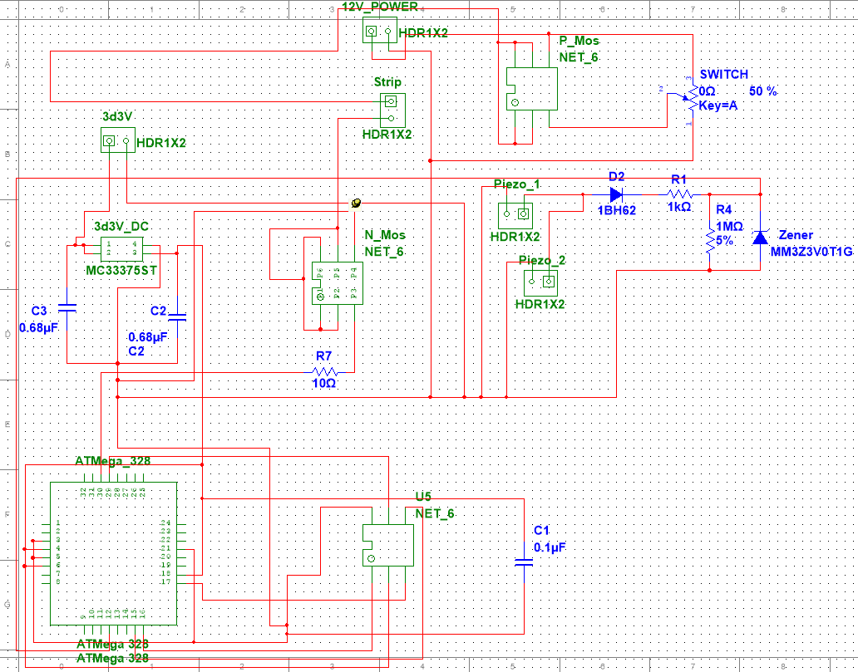
Design

Slide 11
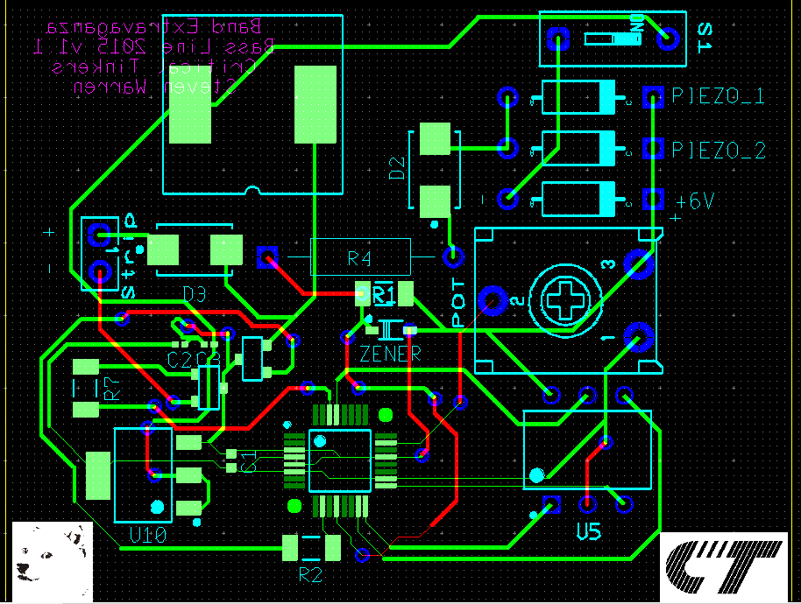
PCB Layout 1.0

Slide 12
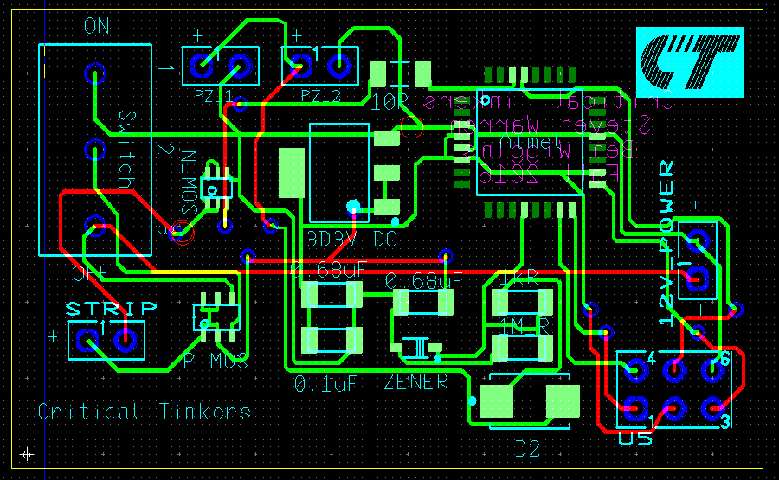
PCB Layout 2.0

Slide 13
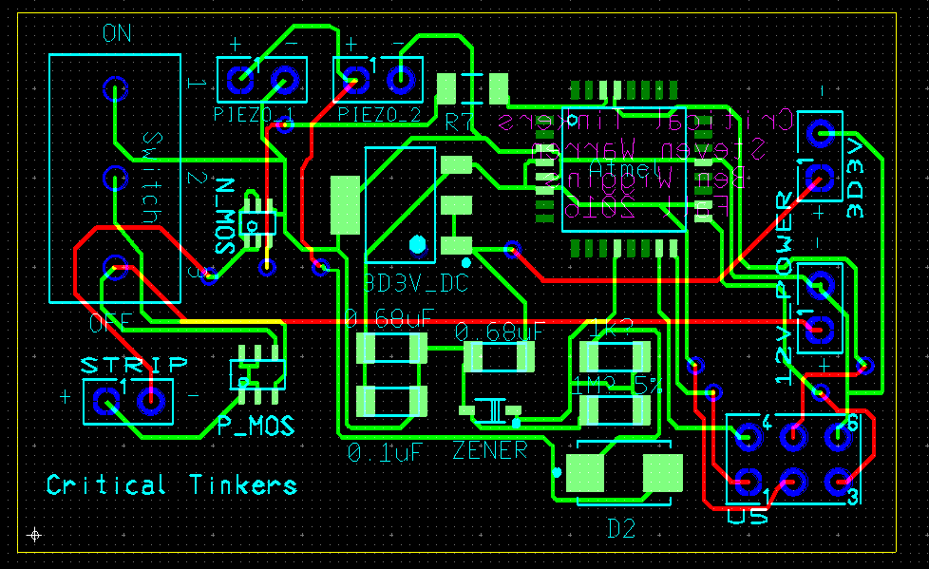
PCB Layout 2.1

Slide 14
Lessons Learned
Plan far ahead of any project deadline you may have (Do NOT Procrastinate)
Have a passion for your project
Make sure to learn some cool skills along the way

